Slide 1
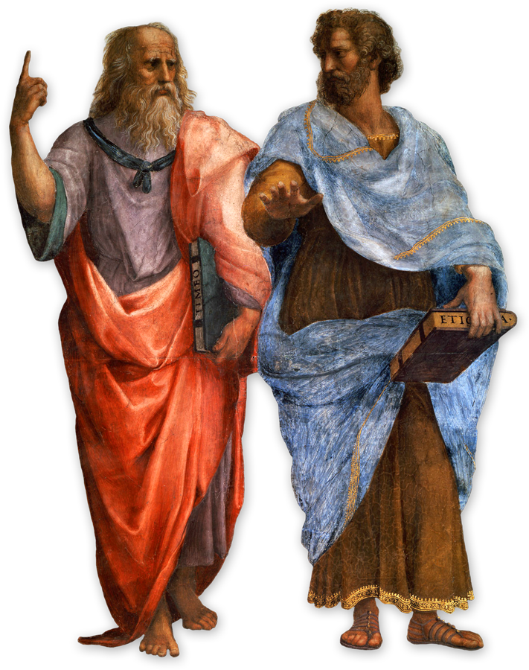
USE NARRATIVE TO BUILD YOUR BRAND
Heider Jeffer

Slide 2

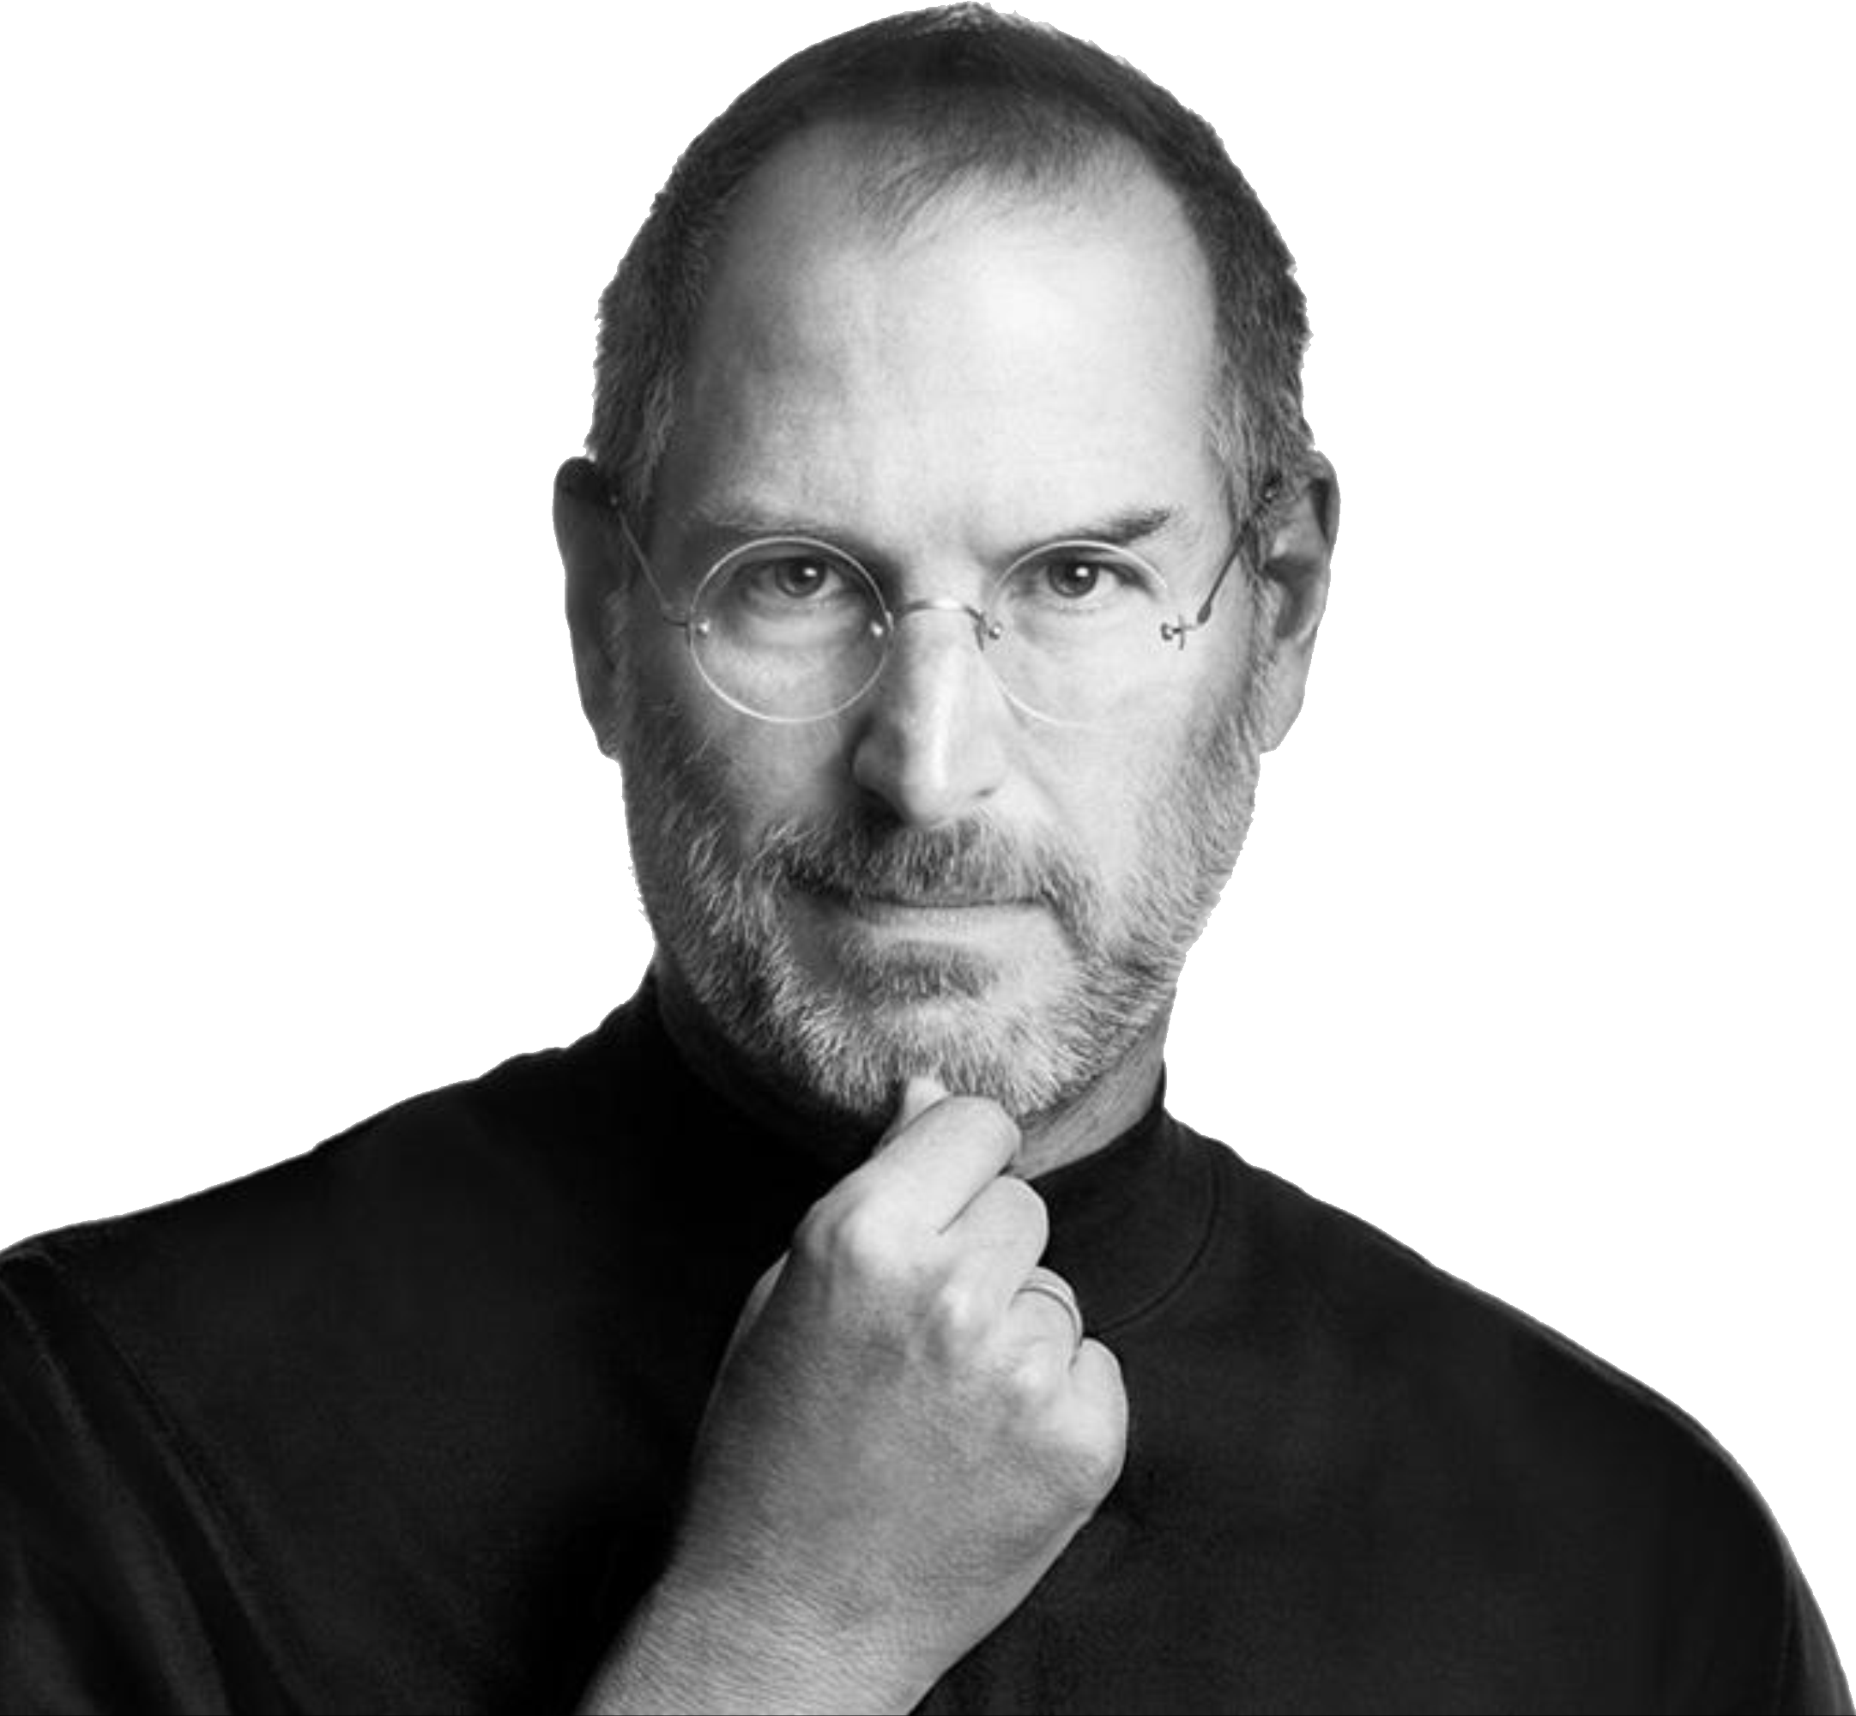
“The most powerful person in the world is the story teller “ - Steve Jobs
Notes:
One way of building internal passion for brands is through the creation of stories. The Story teller sets the vision, values and agenda of an entire generation that is to come

Slide 3
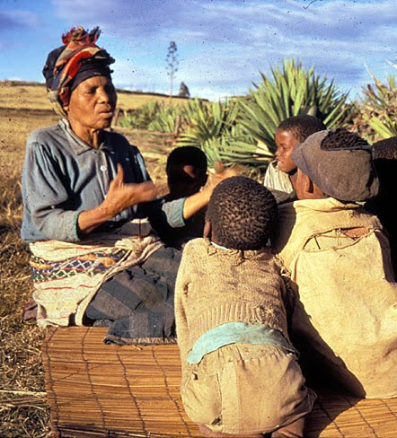
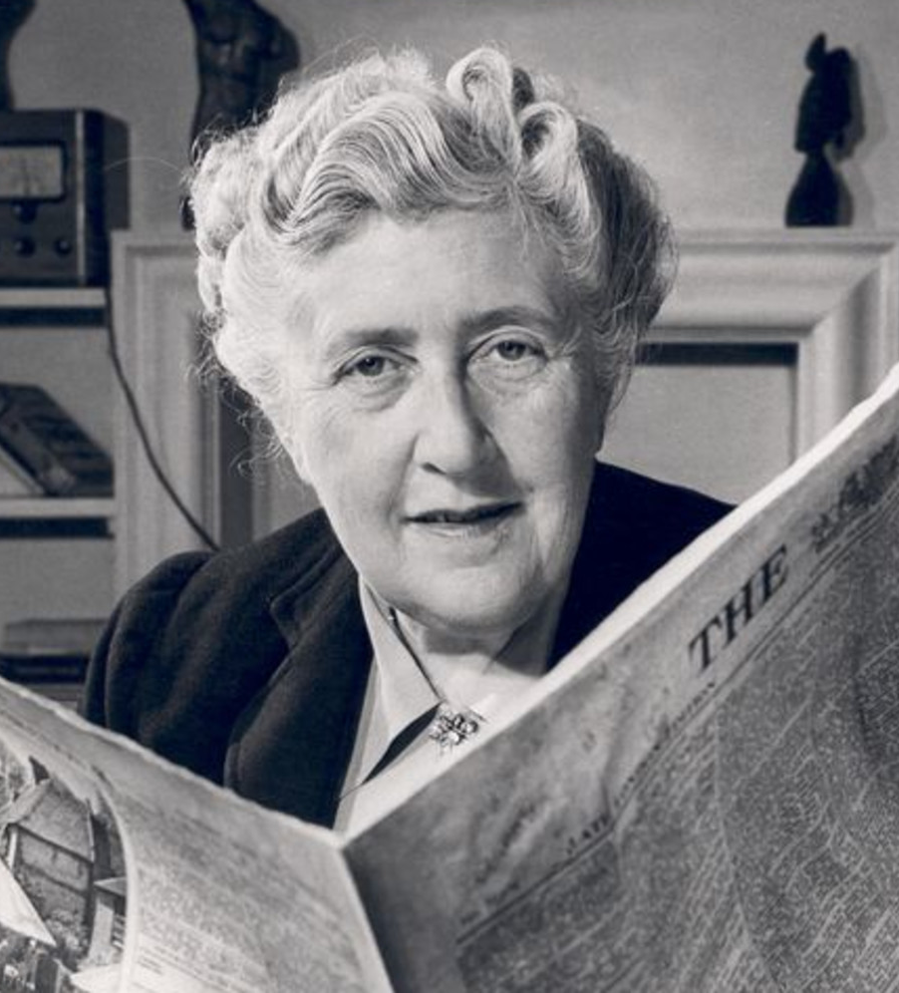
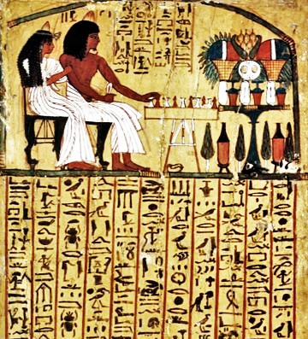
Humans connect with stories
Notes:
1 Telling and sharing stories is fundamental human activity (even when talking to ourselves)
2 Thousands of years ago, history was recorded through narrative cave paintings and Egyptian hieroglyphics.
3 Today, books, movies, art, web sites and social media created a new narrative landscape that is evolving more rapidly than ever.

Slide 4
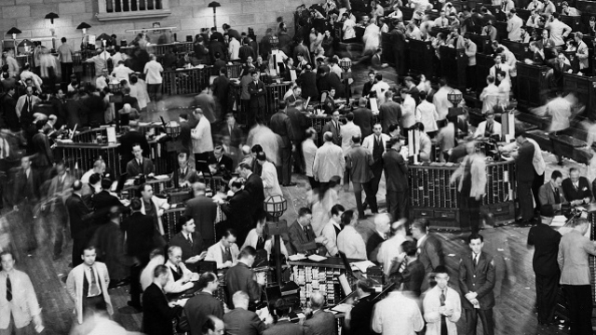
The Marketing of the 20TH

Slide 5
The Marketing of the 20TH
One-way messages
Sellers have all the power
Buyers had no power.
Hard for Buyrs to talk back
Notes:
1. In 20th century the communicating is one-way messages to a mass audience.
2. By mass-marketing same product distributed in the same way to all buyers.
3. Sellers could reach the largest potential market at the lowest cost.
4. Sellers could interrupt whomever they wanted with any message they cared to transmit.
5. Buyers were forced to watch it because there were only three television channels.
6. There was no easy way for buyers to talk back for or against the product.

Slide 6
The Marketing of the 21st Century

Slide 7
Why the Model Changed?
First Change: Buyers Have The Power
Second Change: is the fragmentation of media.
Third Change: is technological
Fourth Change: is social.
Notes:
Buyers can access to any reliable information
As a result, unless customers are receiving a continuously added value from the firm, they can—and will—go elsewhere.
This in itself is a game changer: the firm’s goal shifts from merely satisfying customers to the more complex goal of delighting them.

Slide 8
Why the Model Changed?
First Change: is the shift in the balance of power in the marketplace from sellers to buyers.
Second Change: Fragmentation of Media
Third Change: is technological
Fourth Change: is social.
Notes:
A few channels have exploded into multiple channels of television, the Web, and cell Phones Reaching a large audience becomes very expensive unless that
audience wants to be reached.
As a result, mass advertising has diminished cost-effectiveness.
Targeting of advertising to those who are likely to be interested in the advertiser’s products and services becomes a
preoccupation

Slide 9
Why the Model Changed?
First Change: is the shift in the balance of power in the marketplace from sellers to buyers.
Second Change: is the fragmentation of media.
Third Change: The New Technologies
Fourth Change: is social.
Notes:
Word of mouth has always been seen as important: the accepted maxim was that every unhappy customer
told ten friends.
Social media make it wonderfully—and easy for anyone to communicate instantly with anyone else in the world about anything.
Today the dissatisfied buyer can talk back to millions of interested fellow Buyers.
Employee stories about a firm are publicly available on sites
Buyers can band together and use stories to rapidly form alliances that can work powerfully for/or against an organization
Ignoring this groundswell of buyer conversations and stories can be risky.

Slide 10
Why the Model Changed?
First Change: is the shift in the balance of power in the marketplace from sellers to buyers.
Second Change: is the fragmentation of media.
Third Change: is technological
Fourth Change: The Social
Notes:
Buyers are no longer can be manipulated with one-way messages sent
Buyers can investigated the stories that they are being told.
Now customers are able to exploit the power of the new technology to obtain information, address problems, and tell stories, to get what they want.
The twenty-first-century customer is different and more elusive than the customer of fifty years ago.

Slide 11
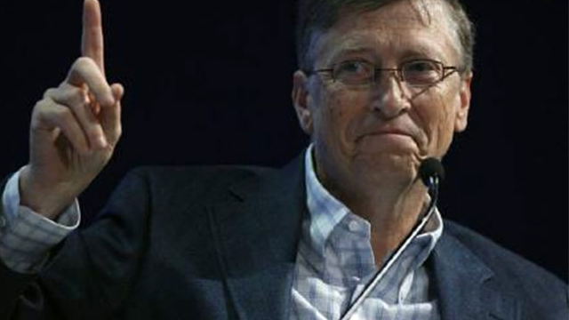
Sellers & Buyers of 21st Century Powerful Advice from Bell Gates
Notes:
“Since when has the world of computer software design been about what people want? This is a simple question of evolution. The day is quickly coming when every knee will bow down to a silicon fist, and you will all beg your binary gods for mercy.”
―Bill Gates

Slide 12
Art and Rules - Brand Stories 21st Century
The Sevens Rules: The Art of Telling Your Brand Story
The Sevens Types of Stories - Which One Is Your Brand Telling?
Notes:
We highly recommended theses two topics to be considered:
Storytelling of course is an ancient art (and part science) which is tackled in so many domains, from the study of ancient cultures to movie making, fiction writing and branding. Yet, it has never been ‘hotter’ than today. The principles and success factors are closely related with word of mouth marketing, social sharing, social media marketing in general, brand perception and the very essence of content marketing.

Slide 13
A. 7 Rules -The Art of Telling Your Brand Story
What is the story and narrative behind everything you do ?

Slide 14
A. 7 Rules -The Art of Telling Your Brand Story
What is the story and narrative behind everything you do ?
How do you actually connect with people in the language they understand best?

Slide 15
A. 7 Rules -The Art of Telling Your Brand Story
What is the story and narrative behind everything you do ?
How do you actually connect with people in the language they understand best?
What types of stories appeal to your content marketing “personas” ?

Slide 16
A. 7 Rules -The Art of Telling Your Brand Story
What is the story and narrative behind everything you do ?
How do you actually connect with people in the language they understand best?
What types of stories appeal to your content marketing “personas” ?
What about the stories your customers and ‘audiences’ are already telling?

Slide 17
A. 7 Rules -The Art of Telling Your Brand Story
What is the story and narrative behind everything you do ?
How do you actually connect with people in the language they understand best?
What types of stories appeal to your content marketing “personas” ?
What about the stories your customers and ‘audiences’ are already telling?
How much ‘control’ can you realistically have?

Slide 18
A. 7 Rules -The Art of Telling Your Brand Story
What is the story and narrative behind everything you do ?
How do you actually connect with people in the language they understand best?
What types of stories appeal to your content marketing “personas” ?
What about the stories your customers and ‘audiences’ are already telling?
How much ‘control’ can you realistically have?
How can you use storytelling in less branding-related ways?

Slide 19
A. 7 Rules -The Art of Telling Your Brand Story
What is the story and narrative behind everything you do ?
How do you actually connect with people in the language they understand best?
What types of stories appeal to your content marketing “personas” ?
What about the stories your customers and ‘audiences’ are already telling?
How much ‘control’ can you realistically have?
How can you use storytelling in less branding-related ways?
How do you make use of digital information and the user generated content?

Slide 20
7 Types of Stories Which One Is Your Brand Telling?
OVERCOMING THE MONSTER
RAGS TO RICHES
THE QUEST
VOYAGE AND RETURN
COMEDY
TRAGEDY
REBIRTH

Slide 21
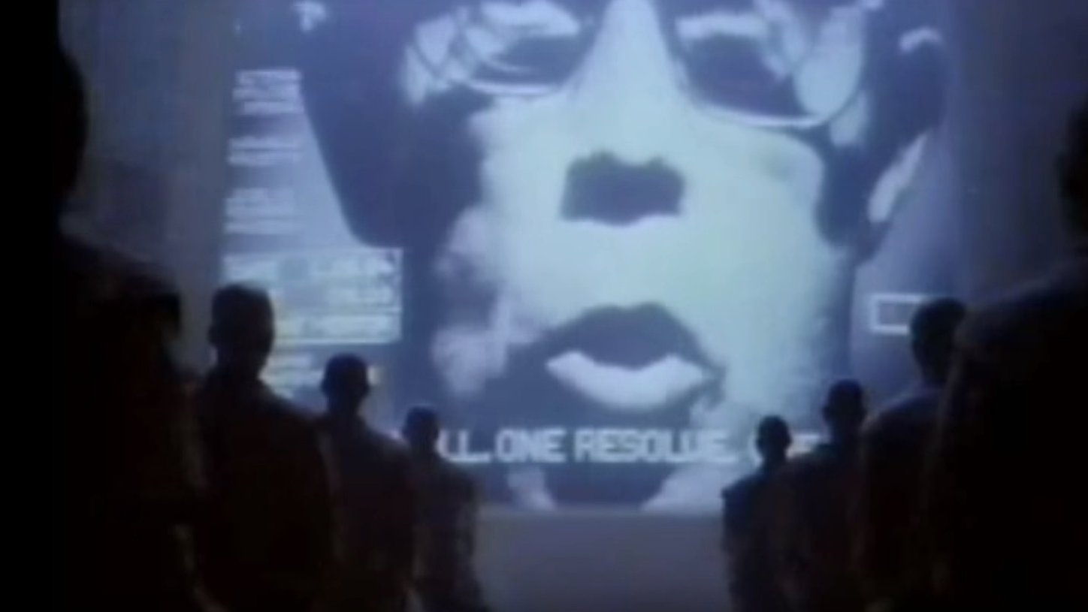
OVERCOMING THE MONSTER Apple Super Bowl Commercial Introducing Macintosh Computer 1984
Notes:
The quintessential example of this story type: David and Goliath. The basic narrative: plucky underdogs buck the status quo despite apparently insurmountable odds. Think Erin Brockovich and every sports movie you’ve ever seen.
A brand that does a great job of using this narrative is Apple. Even as it has become a behemoth, its brand purpose of disrupting norms has proved remarkably durable. Its iconic 1984 ad is also a classic example of the “overcoming the monster” narrative. One of Walmart’s most successful ads also works with the Overcoming the Monster narrative.

Slide 22
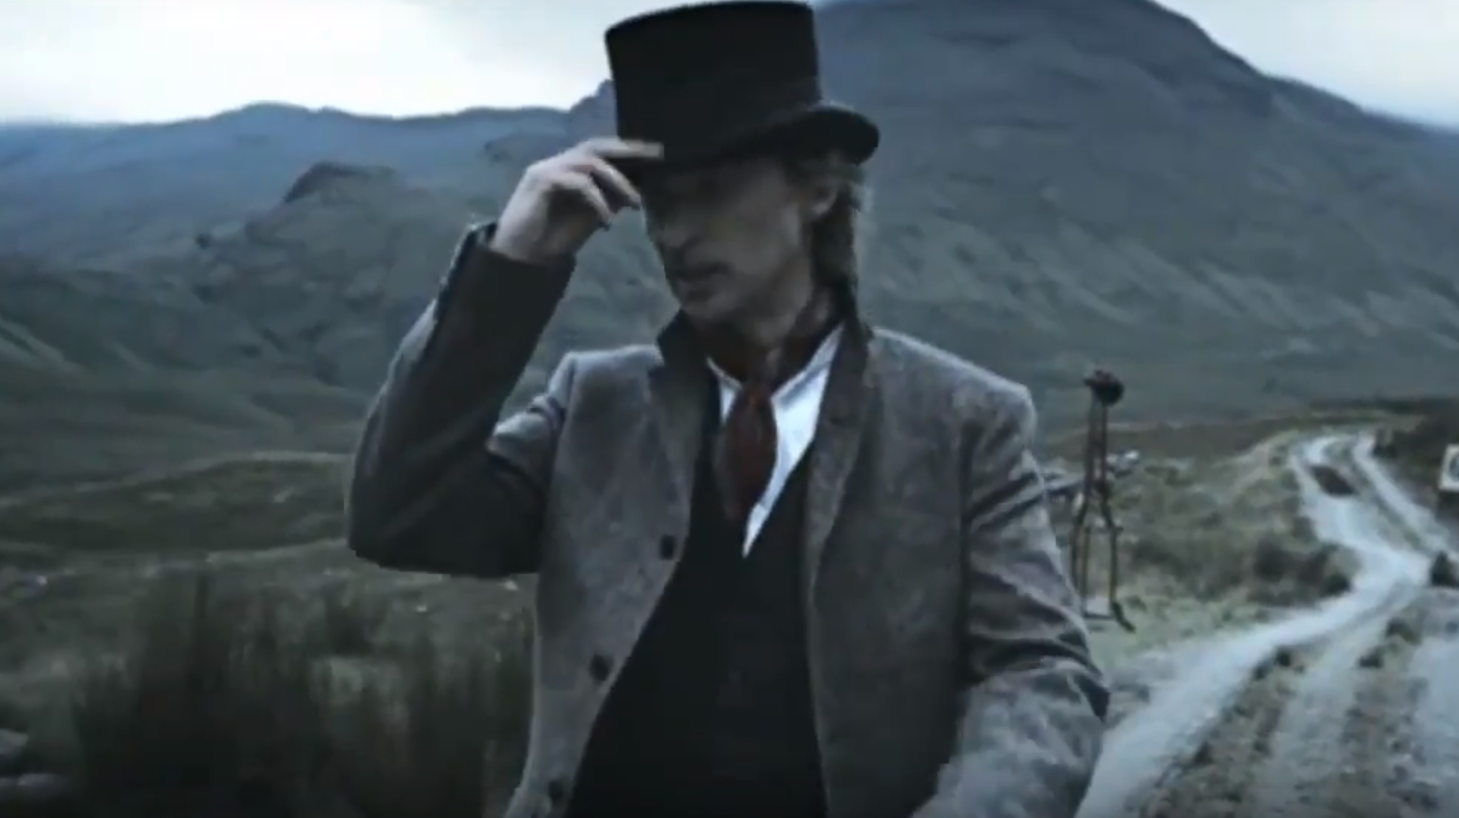
RAGS TO RICHES Whiskey & Weapons - Johnnie Walker - The Man Who Walked Around The World 2013
Notes:
This narrative often works best to develop a brand’s reputation as a provider of quality. It also can exploit the vulnerability inherent in the story to make a formidable brand seem open, friendly and approachable. (Think Oprah.)
Johnnie Walker has used this narrative to amplify its brand of resilience and ambition. The Man Who Walked Around the World commercial makes much of Johnnie Walker’s humble origins and marks the exact moment that the brand moved from “farmboy to Edwardian dandy,” complete with top hat.

Slide 23
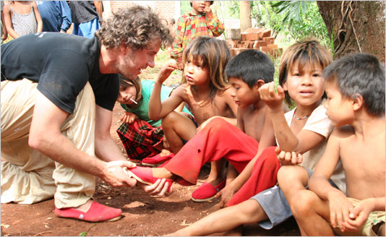
THE QUEST Gives new shoes to children in need. One for One.
Notes:
Quest narratives abound, with their central metaphor being that the journey is worth more than the destination. Think of The Odyssey, The Lord of the Rings or even The Catcher in the Rye. This can be particularly useful for a young brand that is still developing and is in the process of building the origin story of its brand, or defining its why in the mind of the consumer.
TOMS, the shoe manufacturer that gives a pair of shoes to a needy child for every pair of its shoes purchased, emphasizes the quest narrative through its advertising. Its commercials underline the ‘why’ of the company – and actually say very little about the product.

Slide 24

VOYAGE AND RETURN Corona - Find Your Beach (Sand Snow)
Notes:
Voyage and Return is a close cousin of The Quest, but they are differentiated by “the return.” A notable business example is Howard Schulz’s return to the helm of Starbucks after a time spent away. When brands are returning to prior ways of doing business, they are participating in a Voyage and Return narrative. This can be useful for rebranding purposes, or working to restore a brand in crisis.

Slide 25
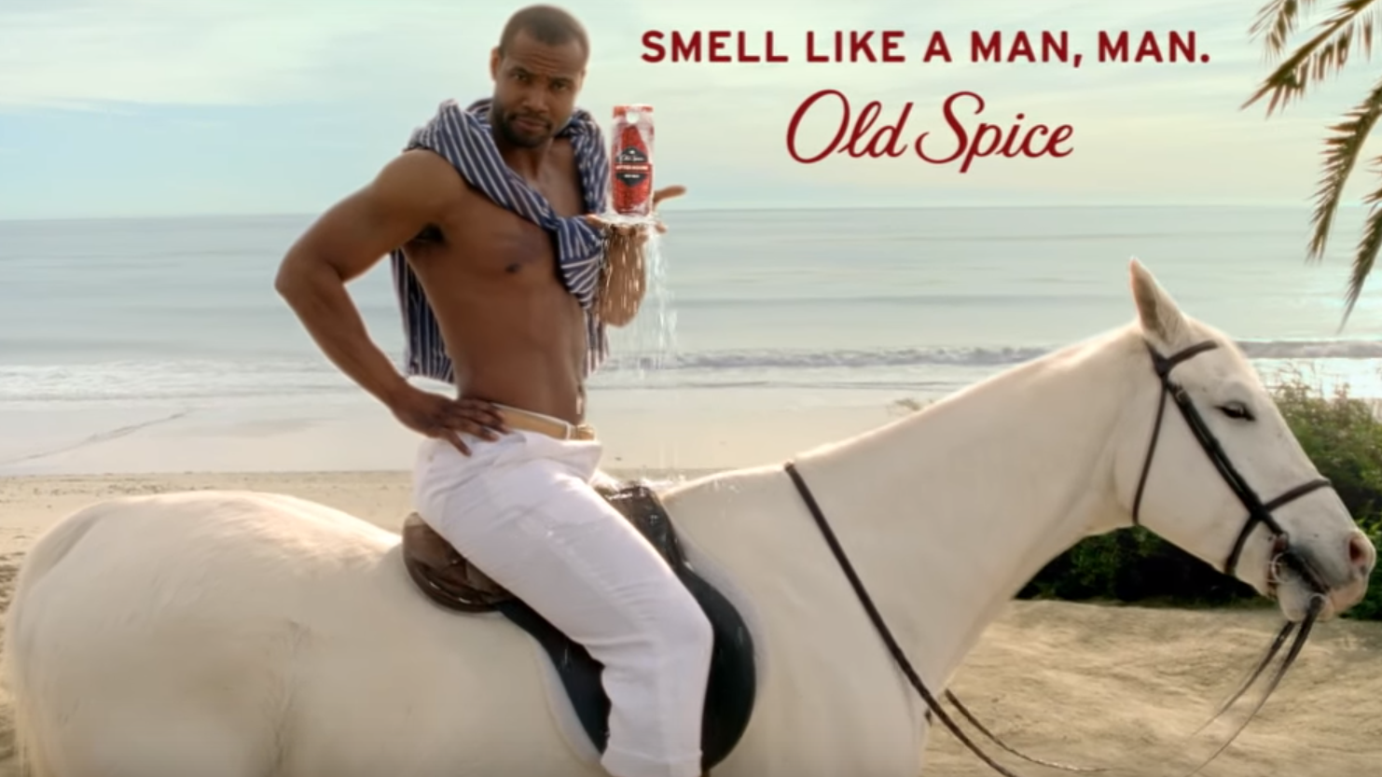
COMEDY Old Spice | The Man Your Man Could Smell Like
Notes:
Many brands effectively use humour to entertain and engage their customers. Classic example: The Man Your Man Could Smell Like. (Well played, Old Spice.)

Slide 26
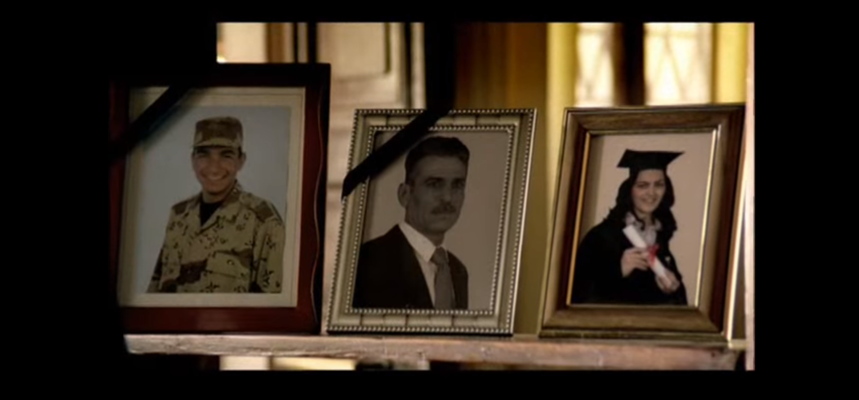
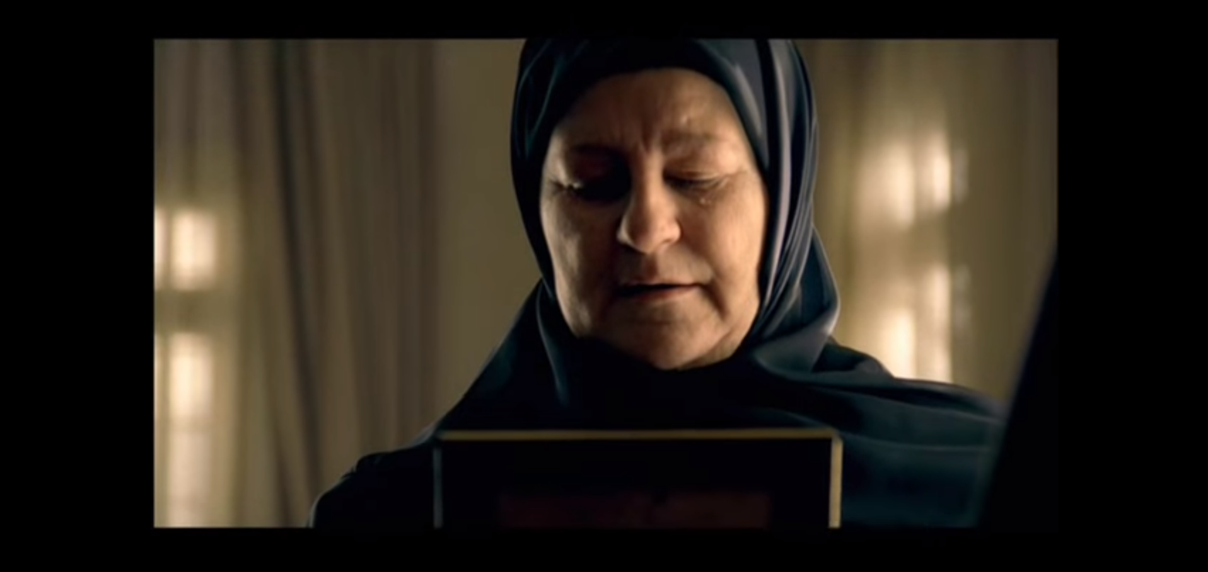
TRAGEDY This ad is part of the Iraqi government's anti-terror campaign
Notes:
Tragedy is mostly off-brand. However, emotional connection is always valuable, and for some organizations, their major function. Many NGOs and charities use tragic stories to help engage deeply with those who may volunteer or donate to their cause.
This ad is part of the Iraqi government's anti-terror campaign.

Slide 27
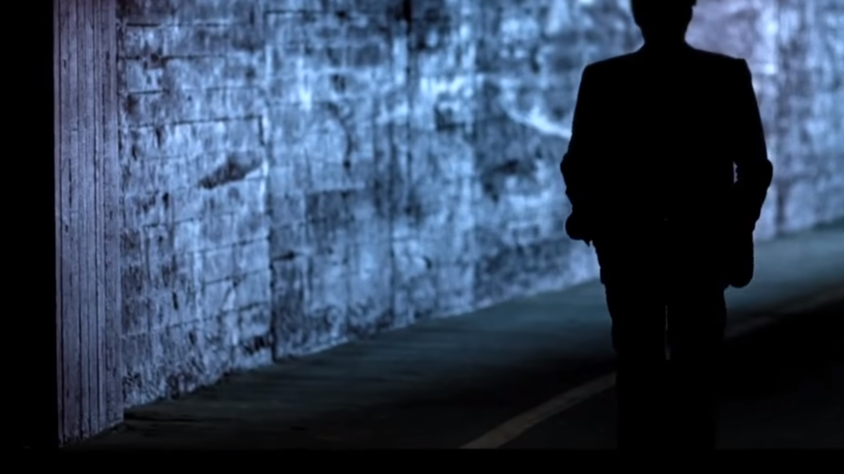
REBIRTH Clint Eastwood Its Half Time America 2012
Notes:
Things always go wrong. The Rebirth narrative is one of the most inspiring, combining vulnerability and success into one powerful package. Chrysler effectively used a Rebirth narrative after the 2008 financial crisis to rehabilitate its brand and image.
The 2012 Super Bowl ad Halftime in America was an inspirational, highly patriotic pitch to the rebirth of American industry and manufacturing. (Plus it had Clint Eastwood. They had their bases covered.)

Slide 28
Conclusion
The Market of 21st century is completely deffrence from the 20th
In 21st century the Buyers have more power than the sellers
Telling and sharing stories is fundamental human activity (even when talking to ourselves)
Storytelling is so much more than telling stories in marketing and communications for businesses of 21st century
If individuals can build trust in themselves by telling their stories, why not organizations of the 21st century do the same?
7 Rules determined The Art of Telling Your Brand Story
7 Types of Stories Which One Is Your Brand Telling?
Notes:
Telling and sharing stories: THE fundamental human activity (even when talking to ourselves)
Storytelling is so much more than telling stories in marketing and communications for businesses. As I explained

Slide 29
THANKS ☺

Slide 30
QUESTIONS ☺

